Slide 1
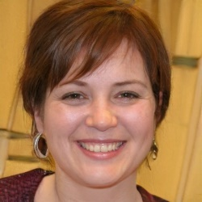
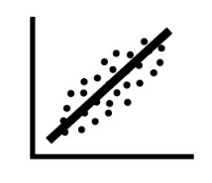

Associate Professor of Biostatistics
Lindsay D'Amato (template, please consult guidebook for how to adapt for your needs)
“I enjoy multidisciplinary collaborative work and the opportunity to learn from a wide variety of scientists with different perspectives.”
Bio
Lindsay's lifelong interest in improving people’s health and happiness led her to the field of biostatistics for her PhD. Working her way up from a junior statistician position in which she cleaned datasets and performed simple analyses, she is now a direct collaborator with PIs on dozens of grant-funded projects each year. She advises researchers on the appropriate statistical approaches for analysis and plays a key role in study design. Many of Lindsay’s projects are multi-center studies, requiring her to travel frequently. She provides mentorship to junior faculty in every stage of the research process, from study design to analysis. Lindsay also advises and mentors Master’s level biostatisticians in her department, helping them along their path of professional development and promotion. Lindsay is grateful for the support of research administration staff and her colleagues in the grant office, who support her project work and assist her as she contributes to grant applications. One challenge Lindsay faces is the lack of an NIH study section to submit to for transdisciplinary grants.
Goals
To foster a biostatistics department for team science, to leverage complementary statistical expertise
Clear communication with PIs about expectations
To gain skills in new statistical programs and methods
Motivators
To get funded grants, thereby confirming viable research analysis design
To receive recognition for vital role biostatisticians play on statistical analyses in research
To report accurate and impactful results
To do accountable, reproducible science that ensures the safety and security of patient data
Software attitude & use
Open to new tools
When research and collaboration tools aren’t working, she experiences delays
Statistical software: SAS, Stata, PASS, R
Research and collaboration: REDCap, EndNote, Box, Trello, Github, Slack, video conferencing software
General: Microsoft Office Suite
Wants/Needs
Formal recognition for collaboration, leadership, and mentorship on team projects
More time to achieve her goals
Institutional support for a biostatistics collaboration unit
A way to track metrics on consulting and collaboration efforts to document productivity
Clear methodology or algorithm for prioritizing requests
Scholarly Outputs
Articles/manuscripts
Conference presentations & posters
Class lectures, materials
Reviews of others’ manuscripts
Grant application contributor
Professional Development
Department supports travel to conferences, workshops, purchasing informational resources
Pain Points
Harmonizing data from many different sources requires complicated behind-the-scenes biostatistics solutions
Working on too many grants at low % effort leads to distraction, lower commitment, and less satisfaction
Mentors Master’s level biostatisticians
Department encourages biostatisticians to pursue their PhDs
Education: BS, Mathematics; MS, Statistics; PhD, Biostatistics Years of experience: 10
Work location: Have laptop, will travel
Wants to pursue a professional statistical certification (PStat) from the American Statistical Association
The CTSA Program National Center for Data to Health (CD2H) is supported by the National Center for Advancing Translational Sciences (NCATS) at the National Institutes of Health (Grant U24TR002306)

